Slide 1
Library Management System

Slide 2
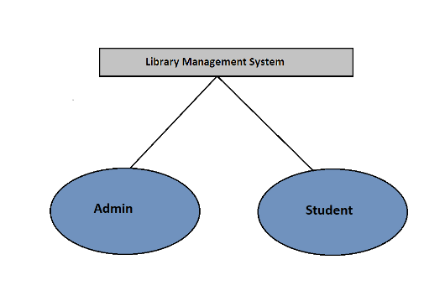
Flow 1

Slide 3
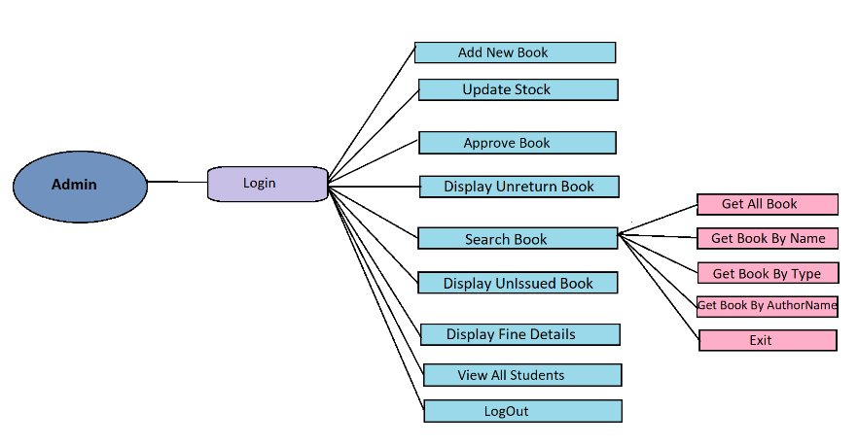
Flow 2

Slide 4
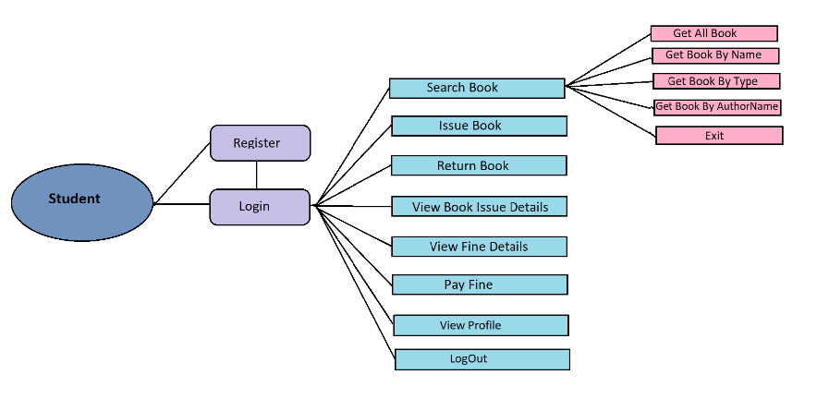
Flow 3

Slide 5
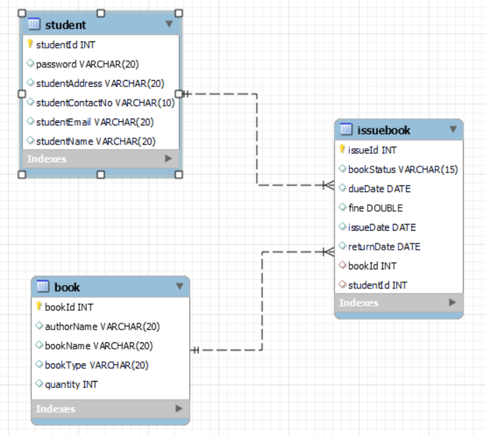
Class Diagram
1:N
1:N
1:N

